Slide 1

IMDB Movie Analysis
By Nayan Jain

Slide 2
Project Description
1) The project focuses on analyzing global IMDb movies to uncover valuable insights. Through careful examination of data, we delve into various criteria including directors, actors, and more. The analysis aims to reveal:
Movies with the highest profitability
Top 250 movies
Outstanding directors
2) Popular genres Utilizing these findings, we create insightful charts to visualize the data effectively. By leveraging this project, we gain a deeper understanding of the movie industry and its key factors for success.
Tech-Stack Used
MS Excel

Slide 3
Approach
It starts with data cleaning to ensure accuracy and reliability.
By applying relevant formulas and data manipulation techniques, we extract specific information from the dataset based on the team's requirements. Understanding the data's context, we identify key steps to extract meaningful insights.
Statistical analysis plays a crucial role in drawing insights from the data, and we leverage charts and visualizations to effectively communicate findings to the company teams.
This approach enables a clear understanding of areas for improvement and facilitates data-driven decision-making.

Slide 4
A) Cleaning the Data
In the data cleaning process, we ensure optimal data organization and quality through the following steps:
Arranging the data in a logical order for easier analysis.
Adjusting column alignment to match row data for consistency.
Removing duplicates using the "Remove Duplicates" option.
Utilizing Filter to select and delete any blank cells in the dataset.
Successfully eliminating around 1500 rows through this meticulous cleaning process.
By implementing these streamlined techniques, we enhance data integrity and prepare a clean dataset for further analysis and insights.

Slide 5
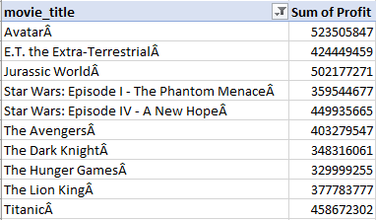
B) Movies with Highest Profit
Here we calculated Profit = Gross - Budget
Then using pivot table these are Top 10 Highest Profit Movies. So, the number one is Avatar with the highest profit

Slide 6
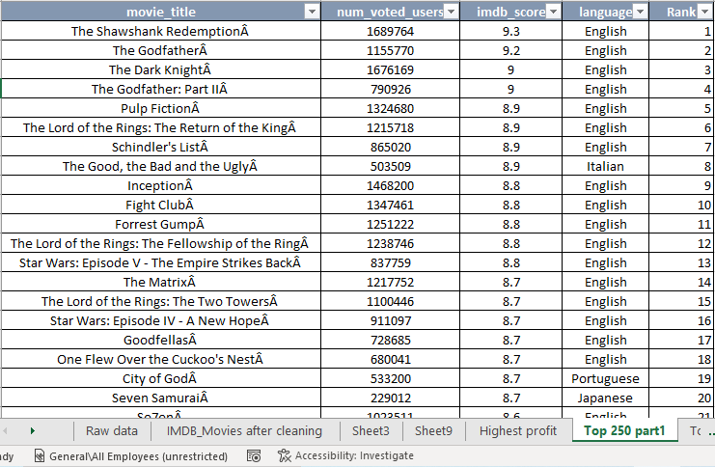
C) Top 250 Movies (Part 1)
Select those movies which have greater than 25000 users of votes
Then Rank them using Rank() function
1st movie is “The Shawshank Redemption” with highest number of voted users and with 9.3 IMDB rating
The 250th movie is “Nine Queens” with 7.9 IMDB rating

Slide 7
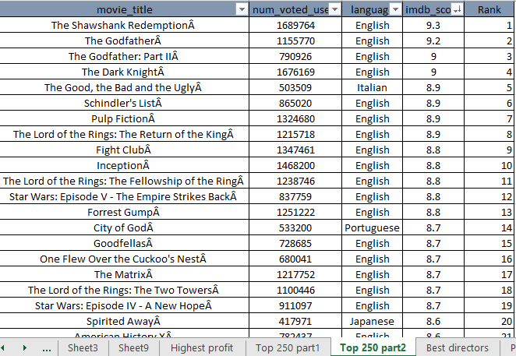
Top 250 Movie (Part 2)
Select those movies which have greater than 25000 users of votes
Then Rank them using Rank() function
Foreign movies can be curated by filtering out Hindi-language films from the selection
1st movie is “The Shawshank Redemption” with highest number of voted users and with 9.3 IMDB rating
The 250th movie is “Twilight” with 5.2 IMDB rating

Slide 8
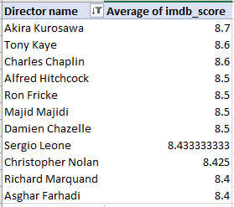
D) Best Directors
These are the best Directors with their average IMDB score and the Top director is Akira Kurosawa.

Slide 9
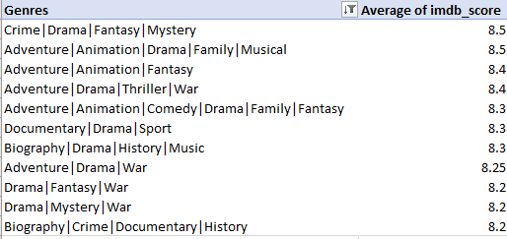
E) Popular Genres
Using genres and IMDb score we create a pivot table and then we find the mean of IMDB score.
Then sort this as a largest to smallest
Score ranges from 8.5 to 8.2

Slide 10
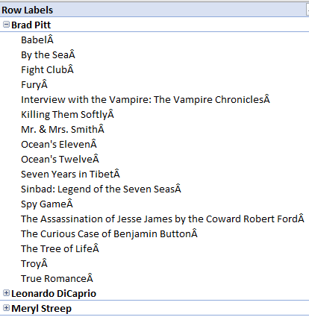
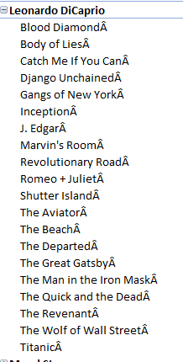
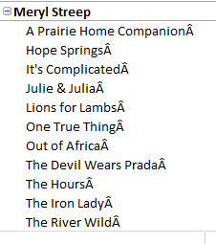
F) Charts
Here we select 2 Actors and 1 Actress : Brad Pitt, Leonardo DiCaprio, and Meryl Streep
So, using pivot table we put their movies under them in which they work as a lead actor or actress

Slide 11

Aggregate ratings of both critics and audience
We Calculate the aggregate ratings of both critics and audience reviews for movies featuring different actors
Leonardo DiCaprio gets the highest number of user reviews and critic reviews

Slide 12
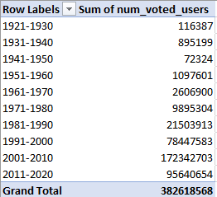
User Votes Over Decades
We calculate the number of votes movies are getting over the decades
Here we can see that number of votes are increasing over the decades and here we can see the trendline going upward
In 2011-2020 number of votes are lesser than previous decade because the data is from 1921 to 2016 that’s it’s lesser than its previous decade

Slide 13

Result
Analysis plays a crucial role in both the pre-production and post-production stages of a movie. It's important to note that the movie's financial success is not solely determined by its IMDB rating.
The actual profit of a movie is based on the number of tickets sold in theaters worldwide, which serves as the primary metric for calculating profitability.
In conclusion, IMDB Movie Analysis, or similar analyses, are conducted not only by movie producers but also by various financiers, stakeholders, and cinema owners as part of the decision-making process prior to film production.

